Slide 1

DESIGN A RC MODEL WITH ULTRASONIC OBSTACLE DETECTION AND AVOIDENCE RADAR SYSTEM
Submitted by
PRANAVAN BUPATHY
CB.EN.P2CEN19001
Guide
Research Associate Mr. SAJITH VARIYAR V.V

Slide 2
OBJECTIVE
This project is aimed at designing a small scale RC model car which is controlled by microcontroller and the movement of the RC is controlled through Bluetooth connected phone interface.
A phone virtual joystick will be used by the user to control the movement of the RC model.
In addition to this system, the RC is mounted with ultrasonic sensor on the top of the RC
The ultrasonic sensor acts as the Radar system that help to detect the near by object with help of that detection the RC is prevented from collision from the near by object during the control of the RC car. This acts as a safety system that helps to save the RC car from collision.

Slide 3
SCOPE
In real life the autonomous cars have such systems which help the control system to learn about the environment and with that information the cars are driven safely
This system helps the autonomous car with the safety measures by detecting the nearby cars and by helping to maintain distance in heavy traffic situation.
The idea of this project is to replicate and replace the autonomous car with sensors as it is used in real autonomous car LIDAR system for best results.
This can act as a breakthrough in technology showing the future way of transportation system and resources that will be available in future.
This system helps to improve the performance of the autonomous car system and by AI it improves the performance of the vehicle movement.

Slide 4
INTRODUCTION
In today's world where everything is evolved by AI, the automotive field has also seen advancements with new automation techniques.
One of such endeavours is the autonomous car which has evolved over the years, trying to get getting better everyday.
With this inspiration, this topic aims to showcase those functionalities in a small scale RC model.
Another innovation is the use of microcontrollers, which are reliable and useful to do the work in an efficient way.
The idea of the project is to use Arduino as the microcontroller and program it to demonstrate the system.

Slide 5
Hardware and Software Requirement
Arduino UNO
Male and female jumper wires
Servo motor
Ultrasonic sensor
RC car chassis
RC wheel
Motor driver
Geared motor
Battery
Bluetooth module
Arduino IDE software
App created from MIT app Inventor

Slide 6
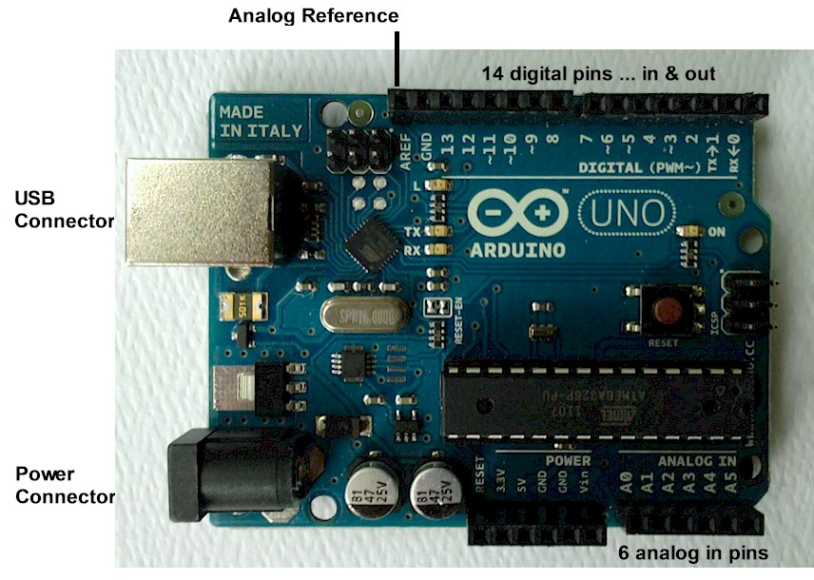
Arduino-Uno
Arduino are microcontroller which is programmed by open source software and there are different types of arduino board available in market.
It is equipped with analogue and digital pin which may be interfaced with various expansion board.
Arduino uno is used as microcontroller in this project.
Design of arduino looks as shown in figure below

Slide 7
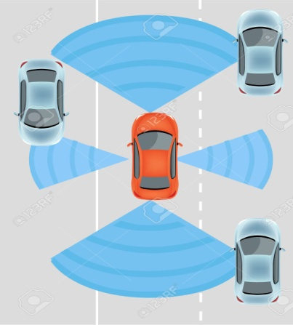
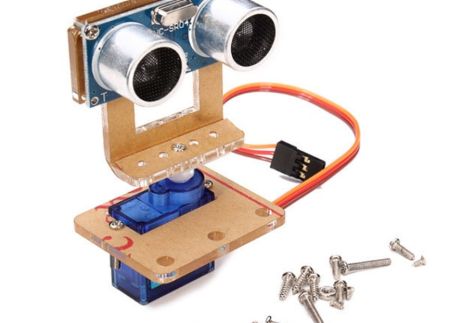
ULTRASONIC SEONSOR AS RADAR
RADAR (Radio detection and ranging) it is a detection system that uses radio waves to determine the range, angle, velocity of objects.
Application are to detect aircraft, ship, spacecraft, guided missiles.
The working of a radar system : It passes radio signal towards the object and the signal hits the object and signal is reflected back. With the time interval the distance of the object is calculated.
Ultrasonic sensor function in the same way and the obstacle is detected by the sensor and with the input the vehicle is programmed to stop and avoid collision.

Slide 8
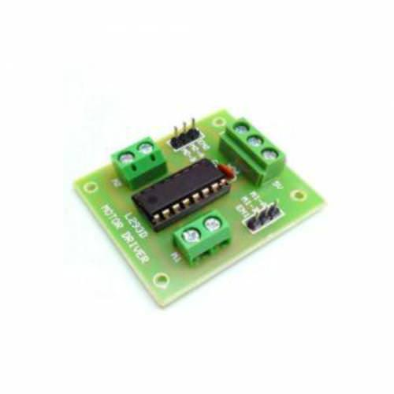
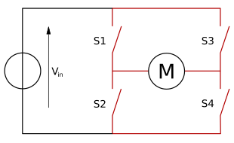
H-Bridge Motor Driver
An H-Bridge motor driver is an electronic circuit that switches the polarity of a voltage applied.
This helps to control the rover to steer right , left and move forward and backward.
By varying and polarising the motor we are able to control the rover
Circuit of H-Bridge looks as shown below

Slide 9
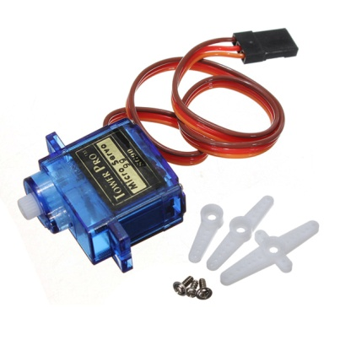
Servo Motor
Servo motor is an electrical device which can rotate or push an object with great precision.
This helps to rotate the ultrasonic sensor to 180 degree which helps to detect object around the rover and it helps to replicate the functionality of radar system.
It works with Pulse Width Modulation which is rotation is controlled by the duration of applied pulse to its control pin
The yellow wire is connected to arduino input pin and red for 5v and brown is connected to ground.

Slide 10
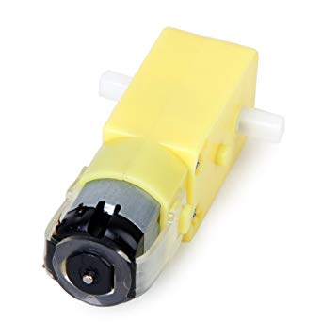
Geared Motors
Geared motor are driving device used to move the rover in which it has geared setup to rotate at varying speed.
According to the input voltage the speed of the motor is set and it can vary from 0 – 12v.
The motor can rotate at 120rpm with full voltage .
Voltage are passed through driver then driver control the voltage and passes the voltage to particular motor.

Slide 11
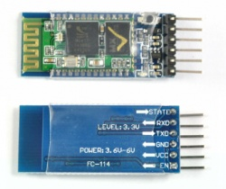
Bluetooth Module
H-05 module is an easy to use Bluetooth (serial port protocol) module used for transparent wireless setup.
It can be used as slave and master according to the application or need.
This Bluetooth module is v2.0 with 2.4Ghz radio transceiver.
Module has Tx transmission ,Rx Recieving pin ,vcc , gnd which are connected through Arduino.

Slide 12
Architecture and flow diagram
User mobile phone
(Forward,Backward,Left,Right,Stop)
Servo Motor
User input
In form of analogue
signal
Ultrasonic radar
analogue
signal
Bluetooth module
Distance
analogue
signal
Ardiuno uno microcontroller
Motor A
0
EnA IN1 IN2
0v
12v
Motor driver
1023
0v
12v
Motor B
EnB IN3 IN4

Slide 13
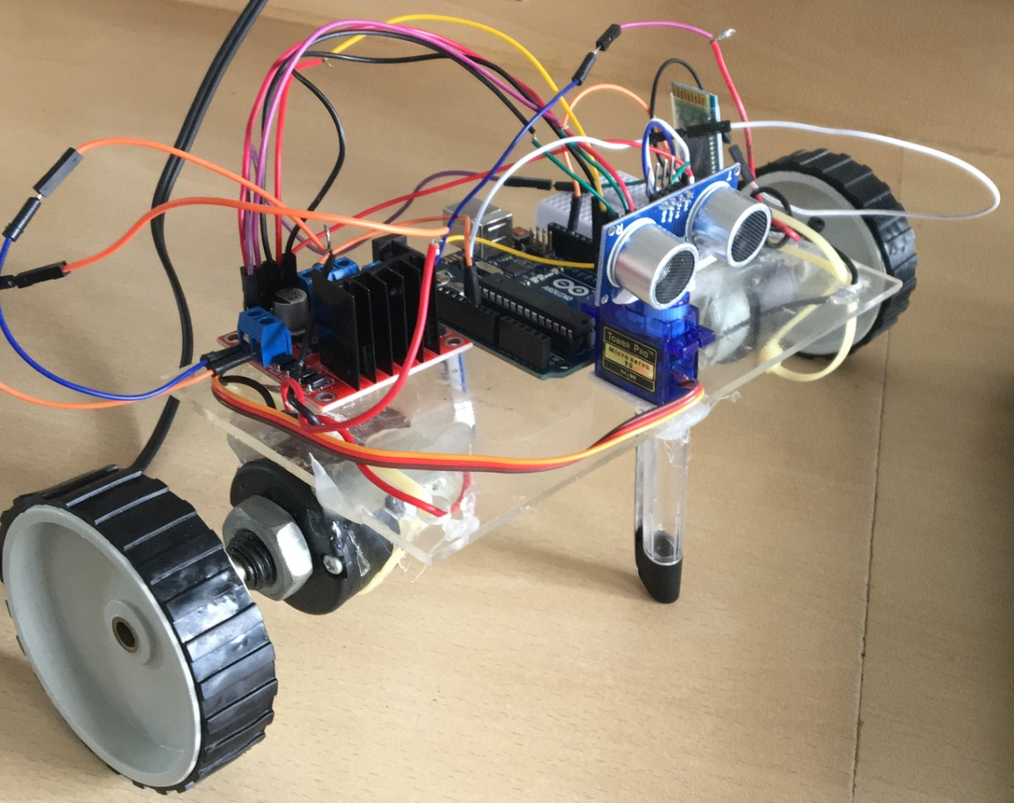
Model

Slide 14
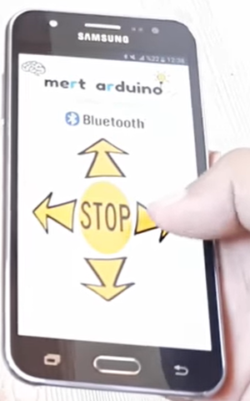
Android Application

Slide 15
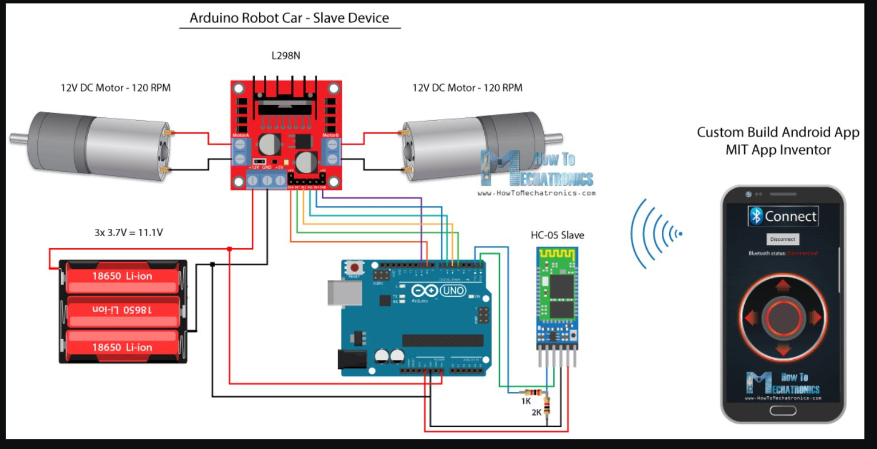
Circuit Diagram
Android app , code , Fritzing diagram are
The following images and code are taken from the reference[1] and the testing is done and following error to be rectified.

Slide 16
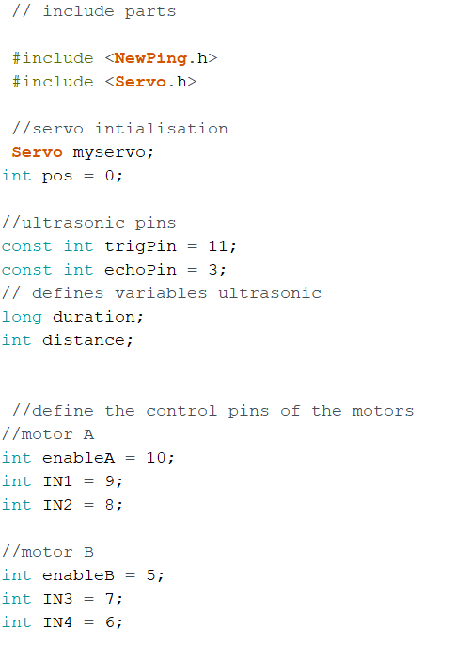
Code used

Slide 17
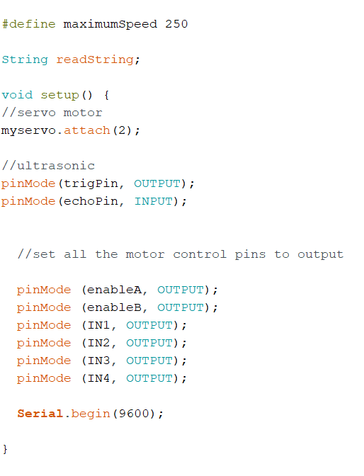

Slide 18
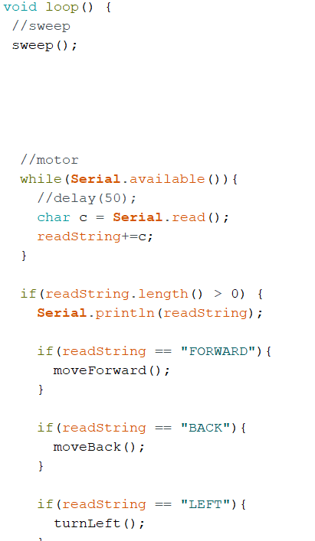

Slide 19
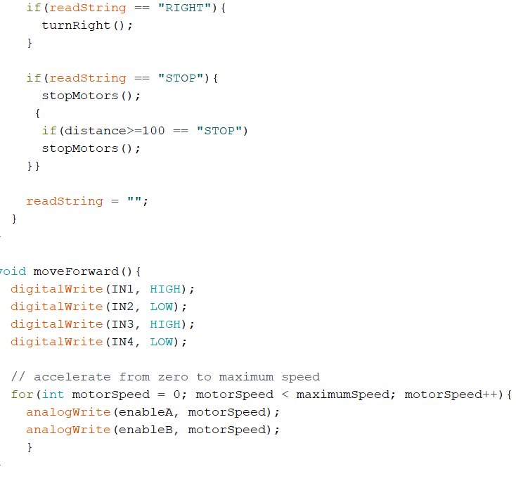

Slide 20
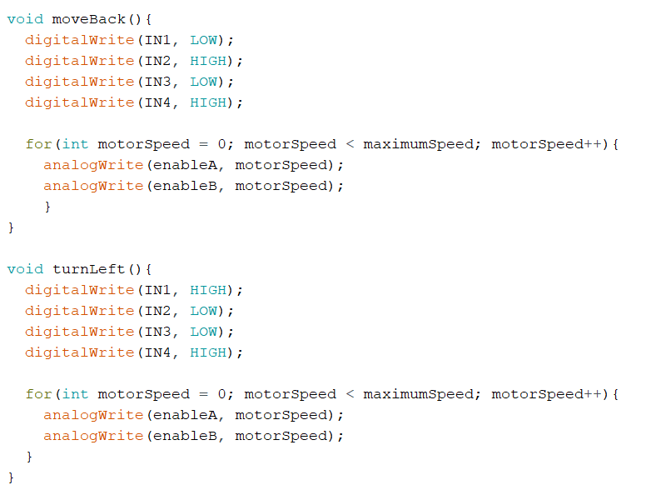

Slide 21
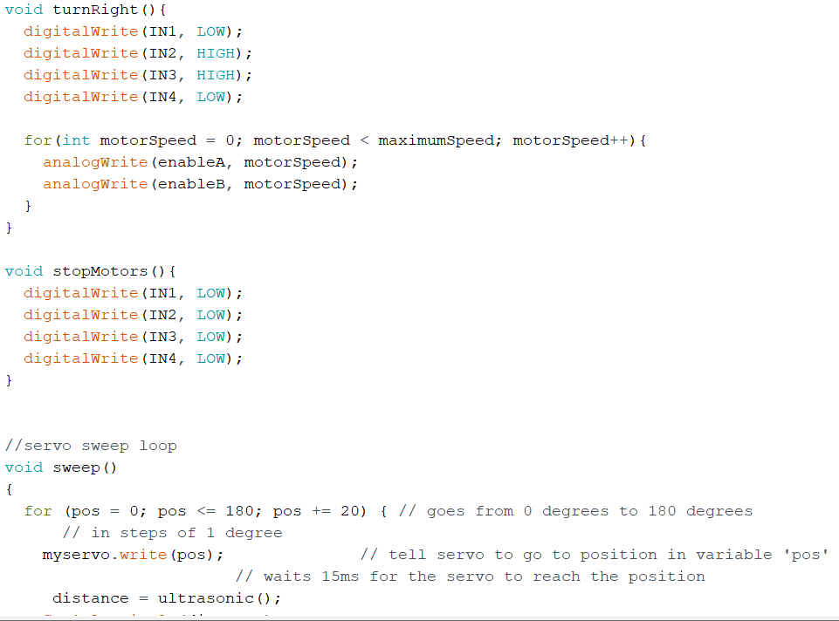

Slide 22
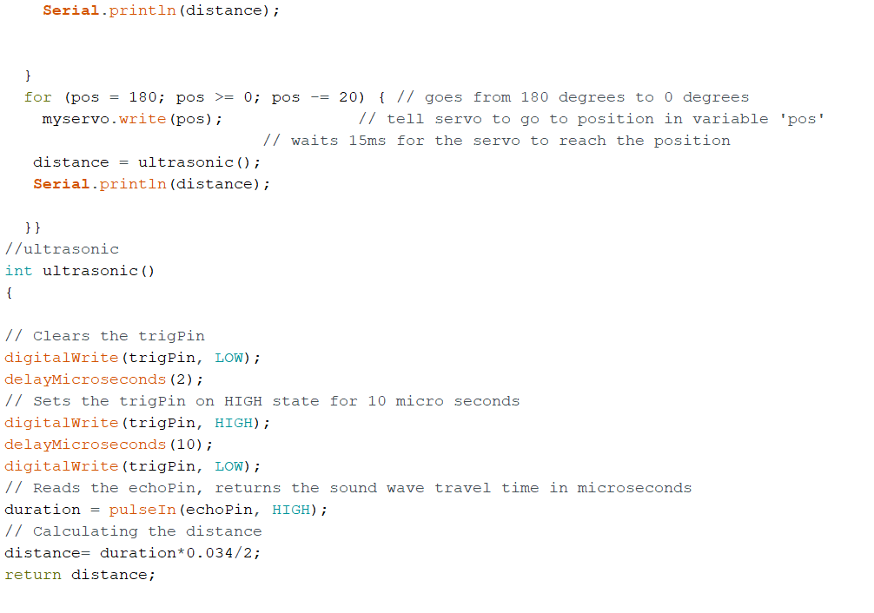

Slide 23

Demonstration Video

Slide 24
THANK YOU

Slide 25
References
https://howtomechatronics.com/tutorials/arduino/arduino-robot-car-wireless-control-using-hc-05-bluetooth-nrf24l01-and-hc-12-transceiver-modules/
https://www.youtube.com/watch?v=1n_KjpMfVT0
https://howtomechatronics.com/projects/arduino-radar-project/
Arduino IDE – Example code

